Slide 1
Lesson 1 Signals
任课教师：刘昱朗
Email: yulangliu@hotmail.com

Slide 2
Outline
Technical Contents
Signals 信号
Audio Signals 音频信号
Image Signals 图像信号
Video Signals 视频信号
Technical Terms

Slide 3
Technical Contents: Signals
What is a signal?
A signal is defined as any function that carries information.

Slide 4
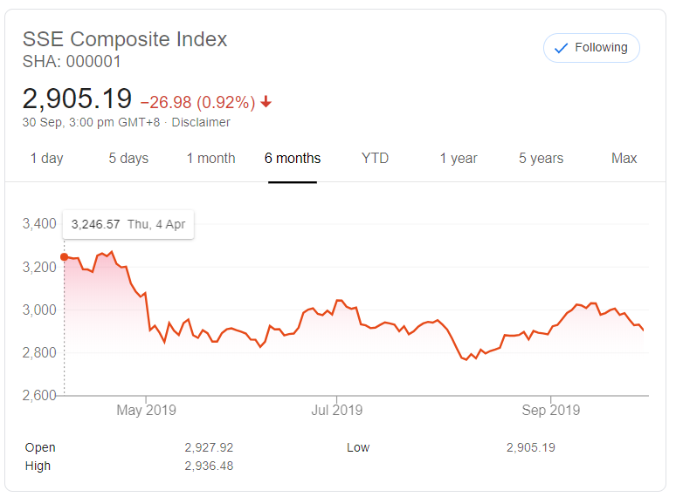
Technical Contents: Signals
Example 1: Shanghai Stock Exchange (SSE) Composite Index

Slide 5
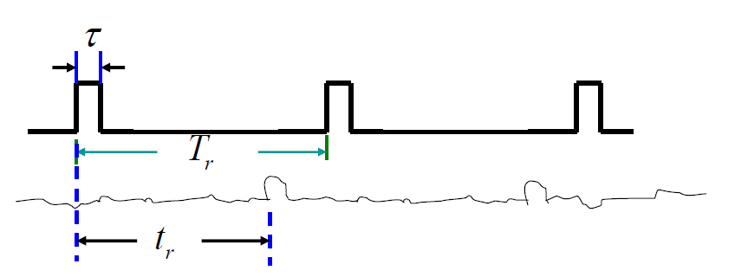



Technical Contents: Signals
Example 2: How does Radar implement ranging ?
Transmitting Signal
Receiving Signal
$$R=\frac{ct_{r}}{2}$$
$$R_{min}=\frac{cτ}{2}$$
$$R_{max}=\frac{cT_{r}}{2}$$

Slide 6
Technical Contents: Signals
Example 3: Image Signal
Creating the MATLAB Logo

Slide 7
Technical Contents: Signals
A signal is defined as any function that carries information.

Slide 8
Audio Signals
视频: https://www.youtube.com/user/Sebasvandenbrink 翻译: bilibili@JonIrenicus11

Slide 9
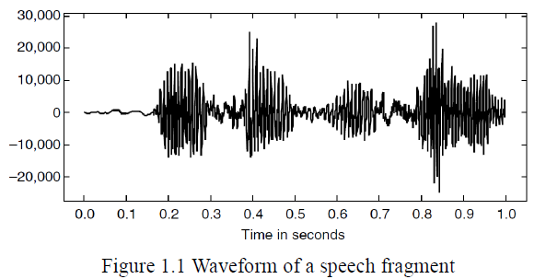

Audio Signals
An audio signal is a temporal function $x(t)$, which represents the air pressure at time $t$.

Slide 10
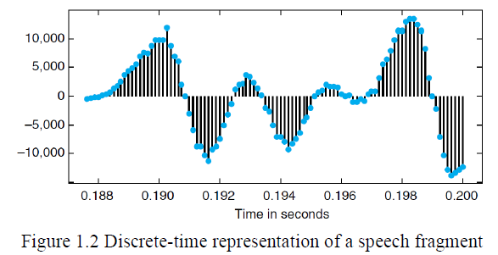
Discretization of Audio Signals
Time discretization 时间离散化
Value (air pressure) discretization 值域离散化

Slide 11



Image Signals
A grayscale image is a spatial function $x(m,n)$, which is the grayscale intensity at pixel $(m,n)$.
A color image is a spatial function $x\left(m,n\right)=\left[r\left(m,n\right),g\left(m,n\right),b(m,n)\right]$, which is the red, green, and blue intensity at pixel $(m,n)$.
The first lady of internet : Lena

Slide 12
Image Signals
The first lady of the Internet : Lena
包含丰富的信息,有低频(光滑的皮肤),也有高频(帽子上的羽毛)，很适合来验证各种算法)
Lena图像的由来

Slide 13
Video Signals
bilibili@面粉社长, av47935041

Slide 14
Video Signals
bilibili@一只度日如年の蛆, av53441881

Slide 15
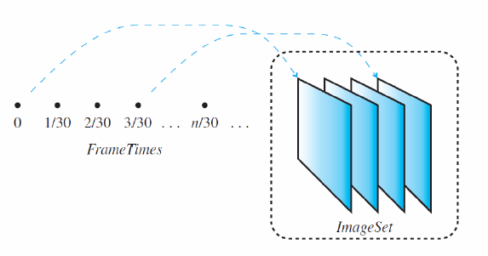

Video Signals
A video signal is a temporal function $f(t)\text{,}$ which is the image/frame at time $t$

Slide 16
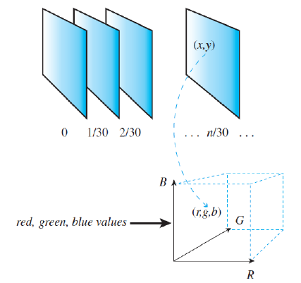

Video Signals
A video signal is a temporal function
$x\left(t,m,n\right)=[r\left(t,m,n\right),g\left(t,m,n\right),b\left(t,m,n\right)]\text{,}$
which is the red, green, and blue intensity at pixel $(m,n)$of the image at time $t$

Slide 17
Video Signals
FPS: Frame Per Second 帧每秒
华为Mate30pro: 7680fps 超级慢动作拍摄
bilibili@华为终端, av70558976

Slide 18
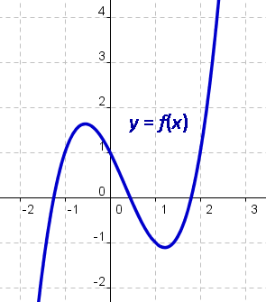
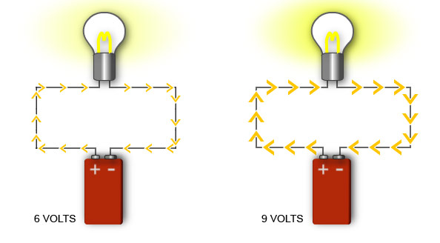
Technical Terms
function n. 函数
independent variable 自变量
dependent variable 因变量
voltage n. 电压；伏特
current 电流
resistance 电阻
power 功率
energy 能量
华为Mate30pro: 7680fps 超级慢动作拍摄

Slide 19
Technical Terms
electrical 电气的，电力的
electronic 电子的
electricity 电力
IEEE: Institute of Electrical and Electronics Engineers
国际电气电子工程师学会
华为Mate30pro: 7680fps 超级慢动作拍摄

Slide 20








Electrical v.s. Electronics
华为Mate30pro: 7680fps 超级慢动作拍摄

Slide 21
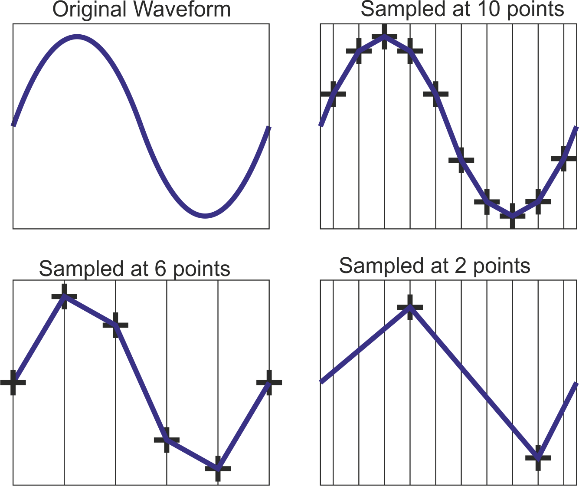
Technical Terms
sample n. 样本，vt. 采样
discretize vt. 使…离散
discrete adj. 离散的
discretization n. 离散化
discrete-time signal 离散时间信号
continuous-time signal 连续时间信号
华为Mate30pro: 7680fps 超级慢动作拍摄

Slide 22
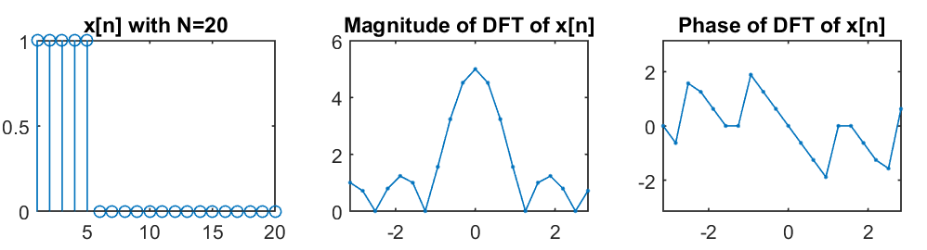
Technical Terms
magnitude n. 幅度，振幅
phase n. 相位
华为Mate30pro: 7680fps 超级慢动作拍摄

Slide 23
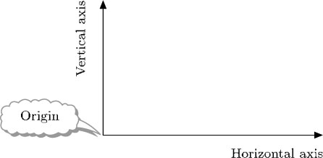
Technical Terms
electromagnetic wave 电磁波
acoustic wave 声波
vertical axis 纵轴
horizontal axis 横轴
origin 原点

